Slide 1
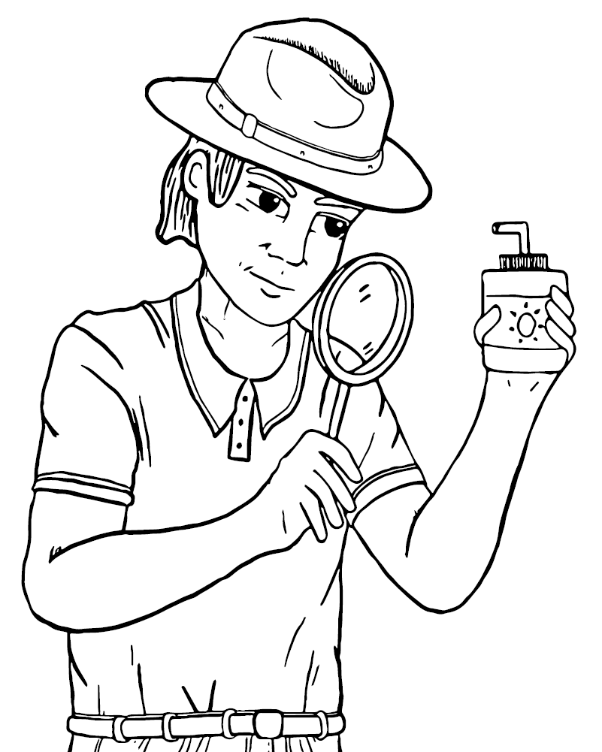
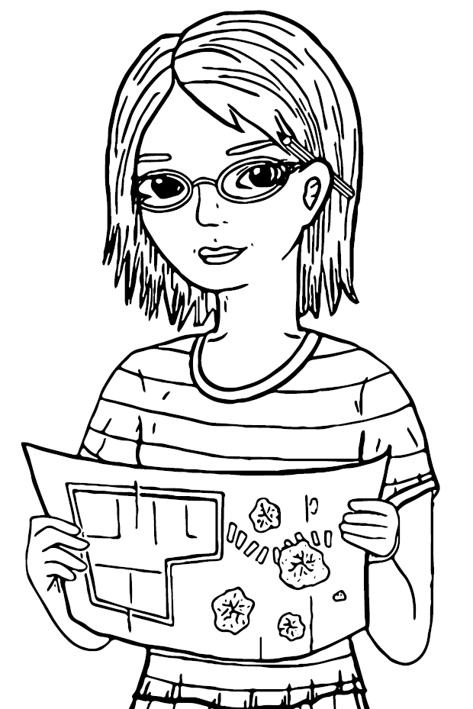
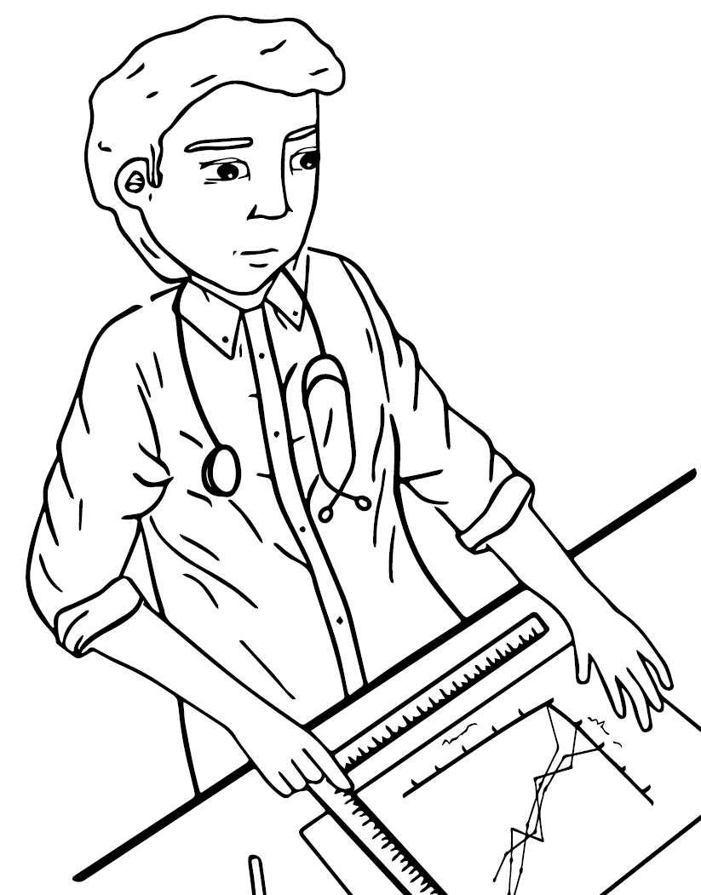
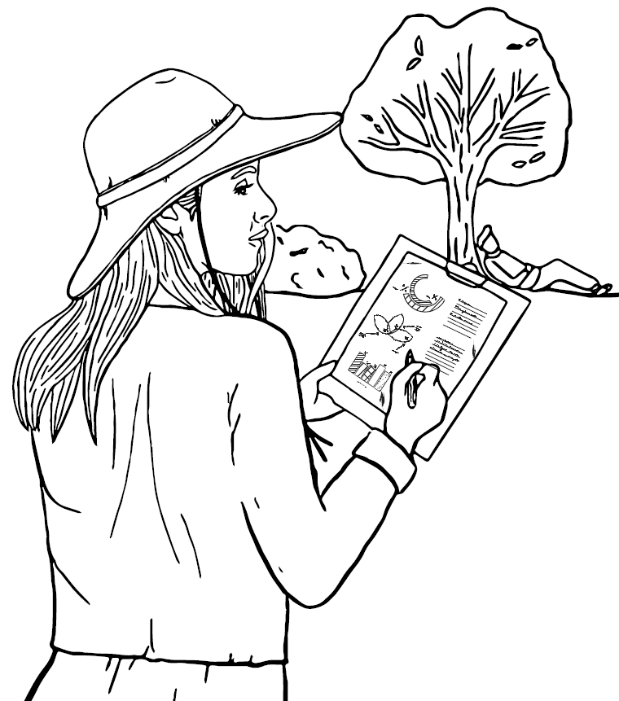



Introduction to specialists
Who do you want to be?

Slide 2
The specialists
Each member of your team will need to specialise in an area and contribute equally.
This might change after the first lesson, so keep an open mind!

Slide 3
The specialists
Myth buster
What is the truth?
Urban design
How could the playground look?
Data doctor
What does the science say?
Demographic
Who is at risk?

Slide 4
The specialists
Myth busters
Do you like to get to the bottom of the truth?
Do you want to ask the tough questions?
Do you want to consider all sides of the story fairly?

Slide 5
The specialists
Urban design
Do you like to know how the environment we live in affects us?
Do you want to change the world we live in?
Do you want to create smart solutions to problems through design?

Slide 6
The specialists
Data doctors
Do you like to find the story in the data?
Do you want to research and analyse the evidence?
Do you want to create solutions based on facts?

Slide 7
The specialists
Demographic
Do you like to understand what makes us human?
Do you want to explore the similarities and differences between us?
Do you want to use the features of people and populations to uncover solutions?

Slide 8
Coming together is a beginning.
Keeping together is progress.
Working together is success. – Henry Ford

