Slide 1

Cervical screening during pregnancy
Information for Antenatal Shared Care Practitioners
NSW Cervical Screening Program May 2025

Slide 2

Acknowledgement of Country
We acknowledge the Traditional Custodians of the lands on which we work and live, and recognise their continuing connection to land, water and community.
We pay our respects to Elders past and present.
Artwork by D.Golding 2016

Slide 3
Overview
Cervical screening, HPV and cervical cancer
Self-collection
Results and management
Cervical screening during pregnancy, including case study
National Cervical Screening Register
Resources and more information
Advice included has been taken from the National Cervical Screening Program: Guidelines for the management of screen-detected abnormalities, screening in specific populations and investigation of abnormal vaginal bleeding (Cancer Council Australia, 2025), which were developed by a team of leading clinical experts and updated in 2025 following evidence reviews, analysis of data from the first 5 years of HPV-based screening.
Notes:
This slide provides an overview of the purpose of the presentation, what is covered in the slides, and a reminder that all clinical advice provided is taken from the National Cervical Cancer Screening Clinical Guidelines (available here: https://app.magicapp.org/#/guideline/Eez2Kj)
This presentation has been developed for practitioners working in Antenatal Shared Care programs, including information on:
Cervical screening, HPV and cervical cancer
Self-collection
Results and management
Cervical screening during pregnancy, including example case study
National Cervical Screening Register
Resources and more information
The presenter present the whole presentation including all slides, or alternatively choose the slides that are relevant/most important for the intended audience. For example for those healthcare professionals who are already well aware of the cervical screening program, you may choose to focus on the screening during pregnancy related slides (6,7,14,15,16,17,18,19,20)

Slide 4

Cervical screening is a public health success story
  Australia has one of the lowest rates of cervical cancer in the world.
  Since 1991 the National Cervical Screening Program has halved the number of cases of cervical cancer and deaths from cervical cancer.
  However over 900 women in Australia are diagnosed with cervical cancer and about 200 women die from the disease every year.
  More than 70% of cervical cancers occur in people who have never screened or who are overdue.
  Australia is on track to be the first country in the world to eliminate cervical cancer as a public health problem by the mid 2030’s.
  We now know what causes most cervical cancers
Notes:
This slides provides an overview of cervical cancer and the role of the cervical screening program in Australia.

Slide 5
HPV is the cause of cervical cancer
Almost all cervical cancer is caused by persistent Human Papillomavirus (HPV) infection that can lead to abnormal cell changes in the cervix – can take 10-15 years for cervical cancer to develop.
HPV is very common, transmitted through sexual contact, ~80% of people have HPV infection at some point in their lives, very few will develop cervical cancer.
Usually asymptomatic. Most HPV clears in 1-2 years.
>100 different types, approximately 15 types are oncogenic including HPV types 16 and 18 which are the most likely to persist and cause around 70% of cervical cancers.
HPV 16 & 18
are the main cancer causing strains
Notes:
This slide provides information about the Human Papillomavirus and its role in cervical cancer.
There are Over 100 different types, approximately fifteen types are oncogenic including HPV types 16 and 18 which are the most likely to persist and cause around 70% of cervical cancers

Slide 6

Cervical screening detects HPV
A Cervical Screening Test every 5 years can prevent cervical cancer
A Cervical Screening Test is a test for HPV, followed by reflex Liquid-Based Cytology (LBC) if oncogenic HPV is found (either HPV16/18 or HPV (not 16/18))
All eligible women now have the choice between:
  clinician-collected sample (from the cervix using a speculum) or
  self-collected vaginal sample using a swab
Who is eligible for cervical screening:
25-74 years old
sexually active, or ever have been
a women or person with a cervix
HPV vaccinated, or not
are pregnant (safe at any time)
Notes:
Women who have any symptoms suggestive of cervical cancer (abnormal vaginal bleeding, unusual discharge, pain during sex) require diagnostic testing rather than screening, and would require a co-test – different to screening pathway.

Slide 7

Video: Cervical screening is safe during pregnancy
Notes:
Video – Cervical screening during pregnancy with Dr Deborah Bateson, 2:25. Link: https://www.youtube.com/watch?v=4anrBwy_Dnc
The National Cervical Screening Program clinical guidelines recommend cervical screening at any time during pregnancy provided that the correct sampling equipment is used. This includes both options - the clinician-collected sample or a self-collected sample. Health professionals, such as GPs, nurses and midwives, play a crucial role in educating patients about cervical screening and performing Cervical Screening Tests.

Slide 8
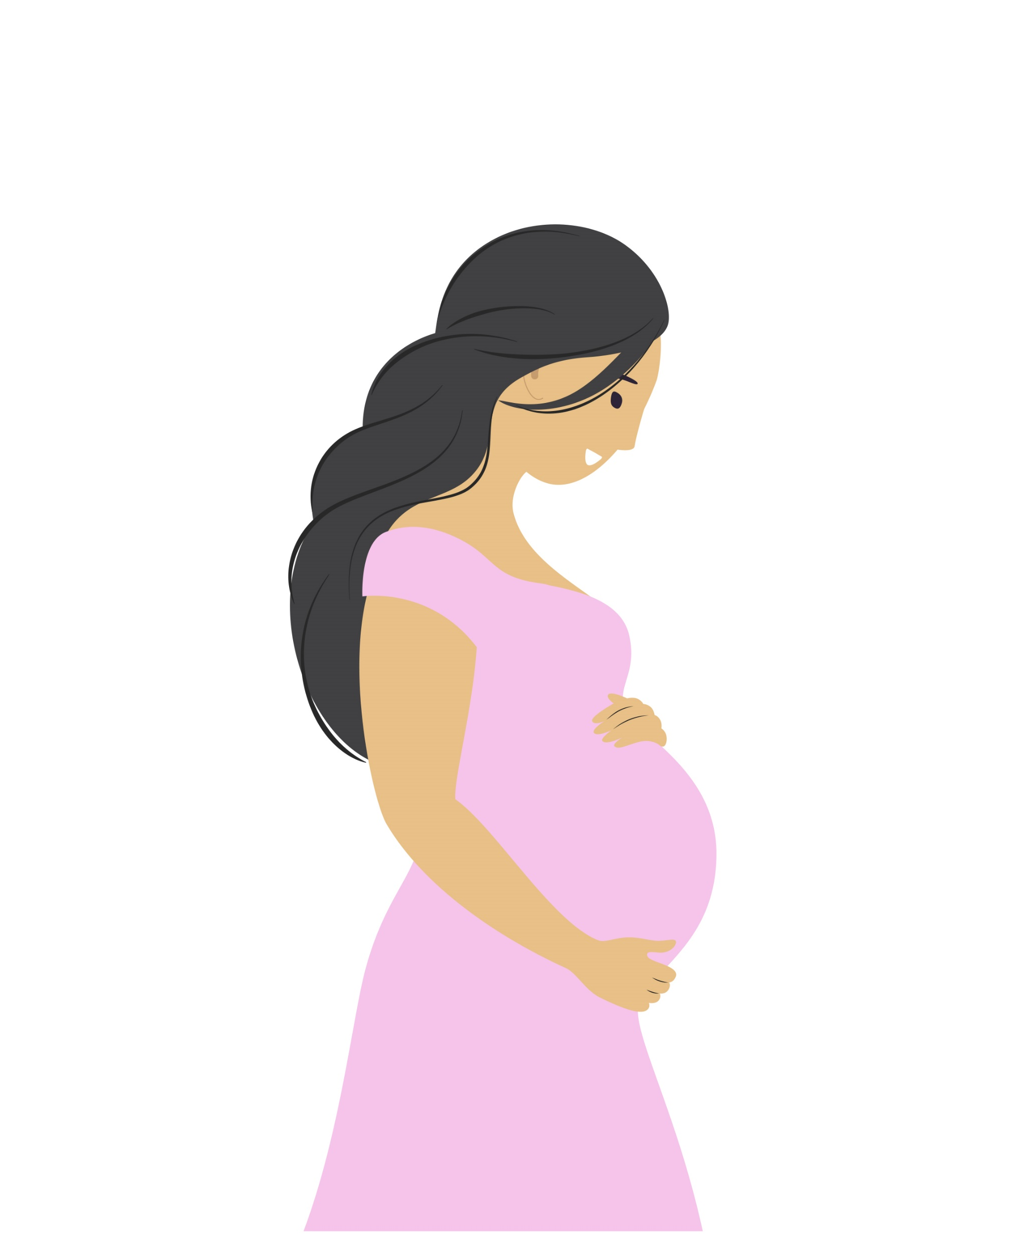
Cervical screening during pregnancy
Cervical screening is safe at any time during pregnancy, including both self-collection and clinician-collection options.
Pregnancy may be the first and only time some women are offered a Cervical Screening Test → an opportunity to reach under and never screened people who may not otherwise attend health services.
  Ask women about their cervical screening history as soon as possible in pregnancy care
  Promote cervical screening to women as an important preventative health screening test and reassure them of the safety of the test during pregnancy, including the option for self-collection
  Perform a Cervical Screening Test at any time during
  pregnancy, using the soft cyto-broom/or swab for self-collection
Reassure women that cervical screening will not harm her pregnancy.
Notes:
Women under 25
Note: The Cervical Screening Program is for women who are 25-74 years of age, and have ever been sexually active. Women who are pregnant and are under 25 years of age are not eligible for cervical screening until 25 years of age and it is recommended to wait until they are 25 to commence screening.
Under the National Cervical Screening Program, routine cervical screening is not recommended for women under 25 years. Some women under 25 will have had previous screening and may present with an expectation to continue.
Medicare does not fund routine Cervical Screening Tests for women under 25.
Any tests submitted to pathology laboratories will need to be privately funded, or with the consent of the referring practitioner, will not be processed.
For information about women who experience sexual activity at a very young age, see the relevant section below ‘Screening women who experienced early sexual intercourse or sexual abuse’.

Slide 9
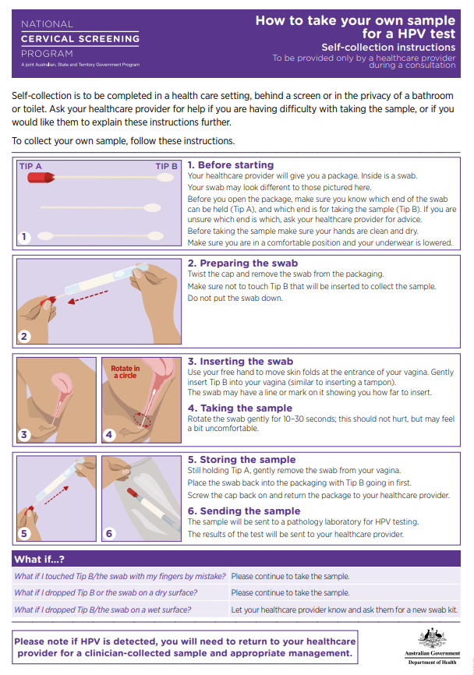
Self-collection of a vaginal sample
  All women have the choice to collect their own sample, including at any time during pregnancy, using a simple swab inserted into lower vagina (not cervix) by the woman
  As accurate in detecting HPV as in a clinician-collected sample*
  A clinician can assist a woman to take a vaginal sample, or collect the vaginal sample, if she is unable to do this herself or prefers clinician to do so
  Removes barriers for some women enabling participation in screening
  Healthcare providers are responsible for informing women of their results and any required follow-up
  Self-collection must be ordered and overseen by a healthcare provider who can also ensure timely clinician-collected testing if required as part of follow-up assessment#
Notes:
*Arbyn, M., et al., Detecting cervical precancer and reaching under-screened women by using HPV testing on self samples: updated meta-analyses. BMJ, 2018. 363: p. k4823.
#This means that healthcare providers who offer self-collection must have identified pathways to ensure that participants with screen-detected abnormalities can access timely provision of clinician-collected sampling if required as part of recommended follow-up ( e.g. for follow-up liquid based cytology (LBC) following a HPV (not 16/18) test result). This does not mean that the person providing self-collection must also be able to provide a clinician-collected sample ( e.g. for follow-up or if clinician-collected screening is preferred); this clinician-collected sample could alternatively be provided by another health care provider.

Slide 10

Discussing self-collection with women
You can choose to collect a vaginal sample yourself using a swab, or I can collect a sample from your cervix (using the speculum) for your Cervical Screening Test.
What would you like to do?
If HPV is found on your self-collected swab, you may need to come back for another appointment for us to collect a sample from your cervix to see if there are any changes which might need treatment or monitoring. If your result shows HPV types 16 or 18 you will be referred straight to a specialist for colposcopy. Is that ok?
A self-collected sample using a vaginal swab can detect Human Papillomavirus (HPV). If no HPV is detected, you can safely screen again in 5 years.

Slide 11
Results and management
Low risk
Intermediate risk
Higher risk
HPV result:
(can be clinician or self collection)
HPV not detected
HPV (not 16/18) detected*
HPV 16/18 detected
+
+
+
No abnormality or low-grade / possible low-grade cytology
High-grade / possible high-grade cytology, any glandular abnormality
Any
LBC result:
(need clinician collection for cervical cells)
Rescreen in 5 years
Repeat test in 12 months
Refer for colposcopic assessment, determine if treatment required
Management recommendation:
*If HPV (not 16/18) detected on self-collected vaginal swab → women to return for clinician-collected sample for LBC to determine risk category
Notes:
Link to the detailed Cervical Screening Pathway (Clinician-collected or self-collected) : https://www.cancer.org.au/assets/pdf/flowchart-6-4-cervical-screening-pathway-for-primary-oncogenic-hpv-screening-hpv-tests-on-clinician-collected-or-self-collected-samples-hpv-not-16-18-detected#_ga=2.132435661.236269599.1692580834-999595616.1664253156
Screening pathways – 3 risk levels
If no HPV detected - Rescreen in five years (Low risk)
If HPV 16 and/or 18 detected - Refer for colposcopy (Higher risk)
If HPV not 16/18 detected*, management depends on cytology:
- If not 16/18 and cytology is negative or low-grade – rescreen in 12 months to check infection has cleared (Intermediate risk)
- If not 16/18 and cytology is high grade – refer for colposcopy (Higher risk)
The pathology report will show the results, the risk level and the management recommendations.
Low-grade cytology is: either no cervical abnormalities, or low-grade squamous intraepithelial lesion (LSIL or possible LSIL)
High-grade cytology is: high-grade squamous intraepithelial lesion (HSIL or possible HSIL) and/or any glandular abnormality
*If the person has self-collected their sample and their result is HPV not 16/18, they will need to return for a clinician collected sample from the cervix to determine management. Less than 1 in 10 women will have a result of not 16/18.
If unsatisfactory result (HPV or cytology) – repeat after 6 weeks

Slide 12
Example pathology report (1)
Clinician-collected cervical sample, no reflex LBC
CERVICAL SCREENING | LOW RISK FOR SIGNIFICANT CERVICAL ABNORMALITY
SPECIMEN | Cervical - ThinPrep® / BD SurePath™
TEST RESULTS | PCR for Oncogenic HPV and genotype: HPV 16 – Not detected HPV 18 – Not detected HPV (not 16/18) – Not detected
RECOMMENDATION | Rescreen in five years
Notes:
This is an example of information that would be provided in a pathology report – in this example is from a clinician collected sample, the risk category result is low risk (which is the result most women can expect to receive), with the recommendation to rescreen in five years.
See Supplement: Sample reports in Chapter 3 of the Guidelines for more examples
https://www.cancer.org.au/clinical-guidelines/cervical-cancer/cervical-cancer-screening/terminology/sample-cervical-screening-reports

Slide 13
Example pathology report (2)
Clinician collected cervical sample with reflex LBC
CERVICAL SCREENING | INTERMEDIATE RISK FOR SIGNIFICANT CERVICAL ABNORMALITY
SPECIMEN | Cervical - ThinPrep® / BD SurePath™
TEST RESULTS | PCR for Oncogenic HPV and genotype: HPV 16 – Not detected HPV 18 – Not detected HPV (not 16/18) – Detected Liquid Based Cytology (LBC), Manually Read: There is no evidence of a squamous intraepithelial lesion or malignancy Endocervical component: Present
RECOMMENDATION | Repeat test in 12 months
Notes:
This is an example of information that would be provided in a pathology report – in this example is from a clinician collected sample, risk category is Intermediate risk, HPV (not 16/18) is detected, with the recommendation to repeat the test in 12 months.
See Supplement: Sample reports in Chapter 3 of the Guidelines for more examples
https://www.cancer.org.au/clinical-guidelines/cervical-cancer/cervical-cancer-screening/terminology/sample-cervical-screening-reports

Slide 14
Example pathology report (3)
Self-collected vaginal sample
CERVICAL SCREENING | HIGHER RISK OF SIGNIFICANT CERVICAL ABNORMALITY
SPECIMEN | Lower vaginal sample – self collected
TEST RESULTS | PCR for Oncogenic HPV and genotype: HPV 16 – Detected HPV 18 – Not detected HPV (not 16/18) – Not detected
RECOMMENDATION | Referral for colposcopic assessment. Cervical sample for Liquid Based Cytology can be obtained at the time of that assessment
Notes:
This is an example of information that would be provided in a pathology report – in this example is from a self-collected sample, the risk category result is Higher risk, HPV 16 is detected, with the recommendation to refer for colposcopy, Cervical sample for LBC can be obtained at the time of colposcopy. *This recommendation is the same for pregnant women. If oncogenic HPV is detected pregnant women should be referred for assessment and not defer until postpartum.
See Supplement: Sample reports in Chapter 3 of the Guidelines for more examples
https://www.cancer.org.au/clinical-guidelines/cervical-cancer/cervical-cancer-screening/terminology/sample-cervical-screening-reports

Slide 15


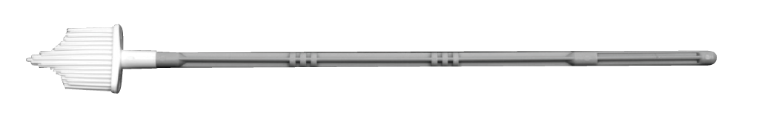
National Cervical Screening Program Clinical Guidelines Recommendations
Routine antenatal and postpartum care should include a review of the person’s cervical screening history. Those who are due or overdue for screening should be screened (REC7.1 )
Cervical screening can be safely performed at any time during pregnancy, provided that the correct sampling equipment is used – the cyto-broom (REC 7.2)
All women and people with a cervix who are due for cervical screening during pregnancy may be offered the option of self collection of a vaginal swab for human papillomavirus (HPV) testing (REC 7.3).
www.cancer.org.au/clinical-guidelines/cervical-cancer/cervical-cancer-screening
Notes:
In the Guidelines, there are 13 practice points and recommendations for management of cervical screening in pregnant women – including the above and on the next three slides. See chapter 14 in the Guidelines for comprehensive information (https://www.cancer.org.au/clinical-guidelines/cervical-cancer/cervical-cancer-screening/screening-in-pregnancy)

Slide 16
Results and management in pregnancy
Pregnant women with low and intermediate risk results → same management pathway.
Pregnant women with higher risk results → follow pregnancy specific recommendations in Section 7.1 of Clinical Guidelines, including:
  HPV (16/18) detected – early referral for early colposcopic assessment when practical and NOT defer until postpartum (REC 7.6)
  HPV (not 16/18) detected and high-grade cell changes (possible HSIL/HSIL) or any glandular abnormalities in pregnancy - early referral for early colposcopic assessment when practical and NOT defer until postpartum (REC 7.5)
  Refer pregnant women with invasive disease to be seen within 2 weeks by a gynaecological oncologist/ gynaecological cancer centre for multidisciplinary team review and management (REC 7.7)
Notes:
Pregnant women who return Low risk and Intermediate risk results follow the same management pathway as women in the general population (as per slide 11). This slide includes recommendations for women who are in the Higher risk category following cervical screening.
Full recommendations are available at: https://www.cancer.org.au/clinical-guidelines/cervical-cancer/cervical-cancer-screening

Slide 17
Colposcopy and biopsy during pregnancy
For pregnant women whose risk level recommends colposcopy, this should NOT be deferred until after pregnancy as colposcopy during pregnancy is to exclude the presence of invasive cancer and to reassure the person that their pregnancy will not be affected by the presence of an abnormal Cervical Screening Test result (REC 7.8).
Colposcopy during pregnancy should be undertaken by a colposcopist experienced in assessing colposcopic findings during pregnancy (REC14.9)
Biopsy of the cervix is usually, unnecessary in pregnancy unless invasive disease is suspected on colposcopy or reflex LBC predicts invasive disease (REC 7.10).
Definitive treatment of a suspected high-grade lesion, except invasive cancer, may be safely deferred until after the pregnancy (REC 7.11).
If postpartum follow-up assessment is required, it should be no less than 6 weeks and preferably at 3 months after birth – optimal time to reduce risk of unsatisfactory LBC result (REC 7.12)

Slide 18
Cervical screening postnatally
Some women may choose to defer cervical screening or are not offered screening until after birth. For these women, offer cervical screening at their postnatal six-week check-up if they are due or overdue or have never been screened.
Optimal time for LBC results is after 6 weeks and preferably at 3 months after birth (e.g. due to the changes occurring in the cervix after birth), however health professionals to make a judgement regarding offering opportunistic cervical screening at six-week check-up to avoid further delays.
Testing for oncogenic Human Papillomavirus (HPV) is accurate at any time.

Slide 19

Case study: Melissa
Your patient:
32 year old woman
20 weeks pregnant, first pregnancy
Antenatal shared care patient
Cervical screening history = never screened
Midwife at hospital booking-in appointment discussed cervical screening with Melissa and recommended she have a Cervical Screening Test
What advice about cervical screening do you give to Melissa when she comes for her routine 20 week antenatal shared care appointment?

Slide 20

Discussion with Melissa
Cervical screening is important to prevent cervical cancer.
It is safe at any time during pregnancy.
You can choose to have your sample collected by a clinician or you can collect your own sample, both are equally accurate in detecting HPV.
If no HPV is detected, next screen in 5 years.
If you choose self-collection and HPV is detected, you may need to return for another appointment to have a clinician-collected sample so that testing can be done on the cervical cells collected.
Notes:
All women should have a Cervical Screening Test every 5 years, including those who have had the HPV vaccination
There is a 1 in10 chance that HPV will be detected following cervical screening. If the woman has chosen self-collection, and HPV not 16/18 is detected, she will need to return to the clinic for a clinician collected sample from the cervix, to determine management recommendation

Slide 21

Melissa’s test results
Melissa chooses to collect her own sample and her result is HPV (not 16/18).
Recall Melissa for clinician-collected sample so that Liquid Based Cytology can be done to determine her risk category and management.
Returns 2 weeks later.
Cytology result is low grade → Intermediate risk
Explain she has intermediate risk result and follow-up HPV test in 12 months is recommended to check that the infection has been cleared.
Melissa can choose to collect her own vaginal sample or to have a clinician-collected cervical sample for the follow-up HPV test in 12 months.
Reassure Melissa that this result will not affect her pregnancy and there is no need for any further testing or treatment during her pregnancy.

Slide 22

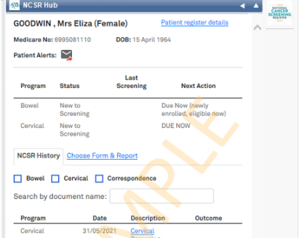
National Cancer Screening Register
Integrated clinical software – makes it easy to check a woman’s Cervical Screening Test history or results
Contact NCSR to check history or results via 1800 627 701
or Healthcare Provider Portal: ncsr.gov.au
Secure and confidential database of screening records:
Invites women at 25, sends reminders when due or overdue
Provides screening histories to labs to inform clinical management
‘Safety net’ - prompts women and providers if HPV is detected and no follow-up or treatment recorded.
Notes:
National Cancer Screening Register (NCSR) – is a single national database, replaced state/territory Pap test registers in 2017 – data migrated. Also supports the National Bowel Screening Program.
Participant Portal
- update details, check dates/results (MyGov)
Healthcare Provider Portal
Submit forms, check dates/results
Need PRODA & Medicare Provider Number (or other Number allocated by the Register – State and Territory Access Number/Register Identifier Number), or act as a delegate
Integration with clinical software
E.g. Medical Director, Best Practice, Communicare
Technical support for NCSR Integration in practice system is also available at the same phone number by calling 1800 627 701.
NCSR guides for healthcare providers:
https://www.ncsr.gov.au/information-for-healthcare-providers/healthcare-provider-forms-and-guides/clinical-information-system-registration-guide/
https://www.ncsr.gov.au/content/dam/ncsr/quick-start-guides/Quick-Start-Guide-Clinical-Software-Integration.pdf

Slide 23
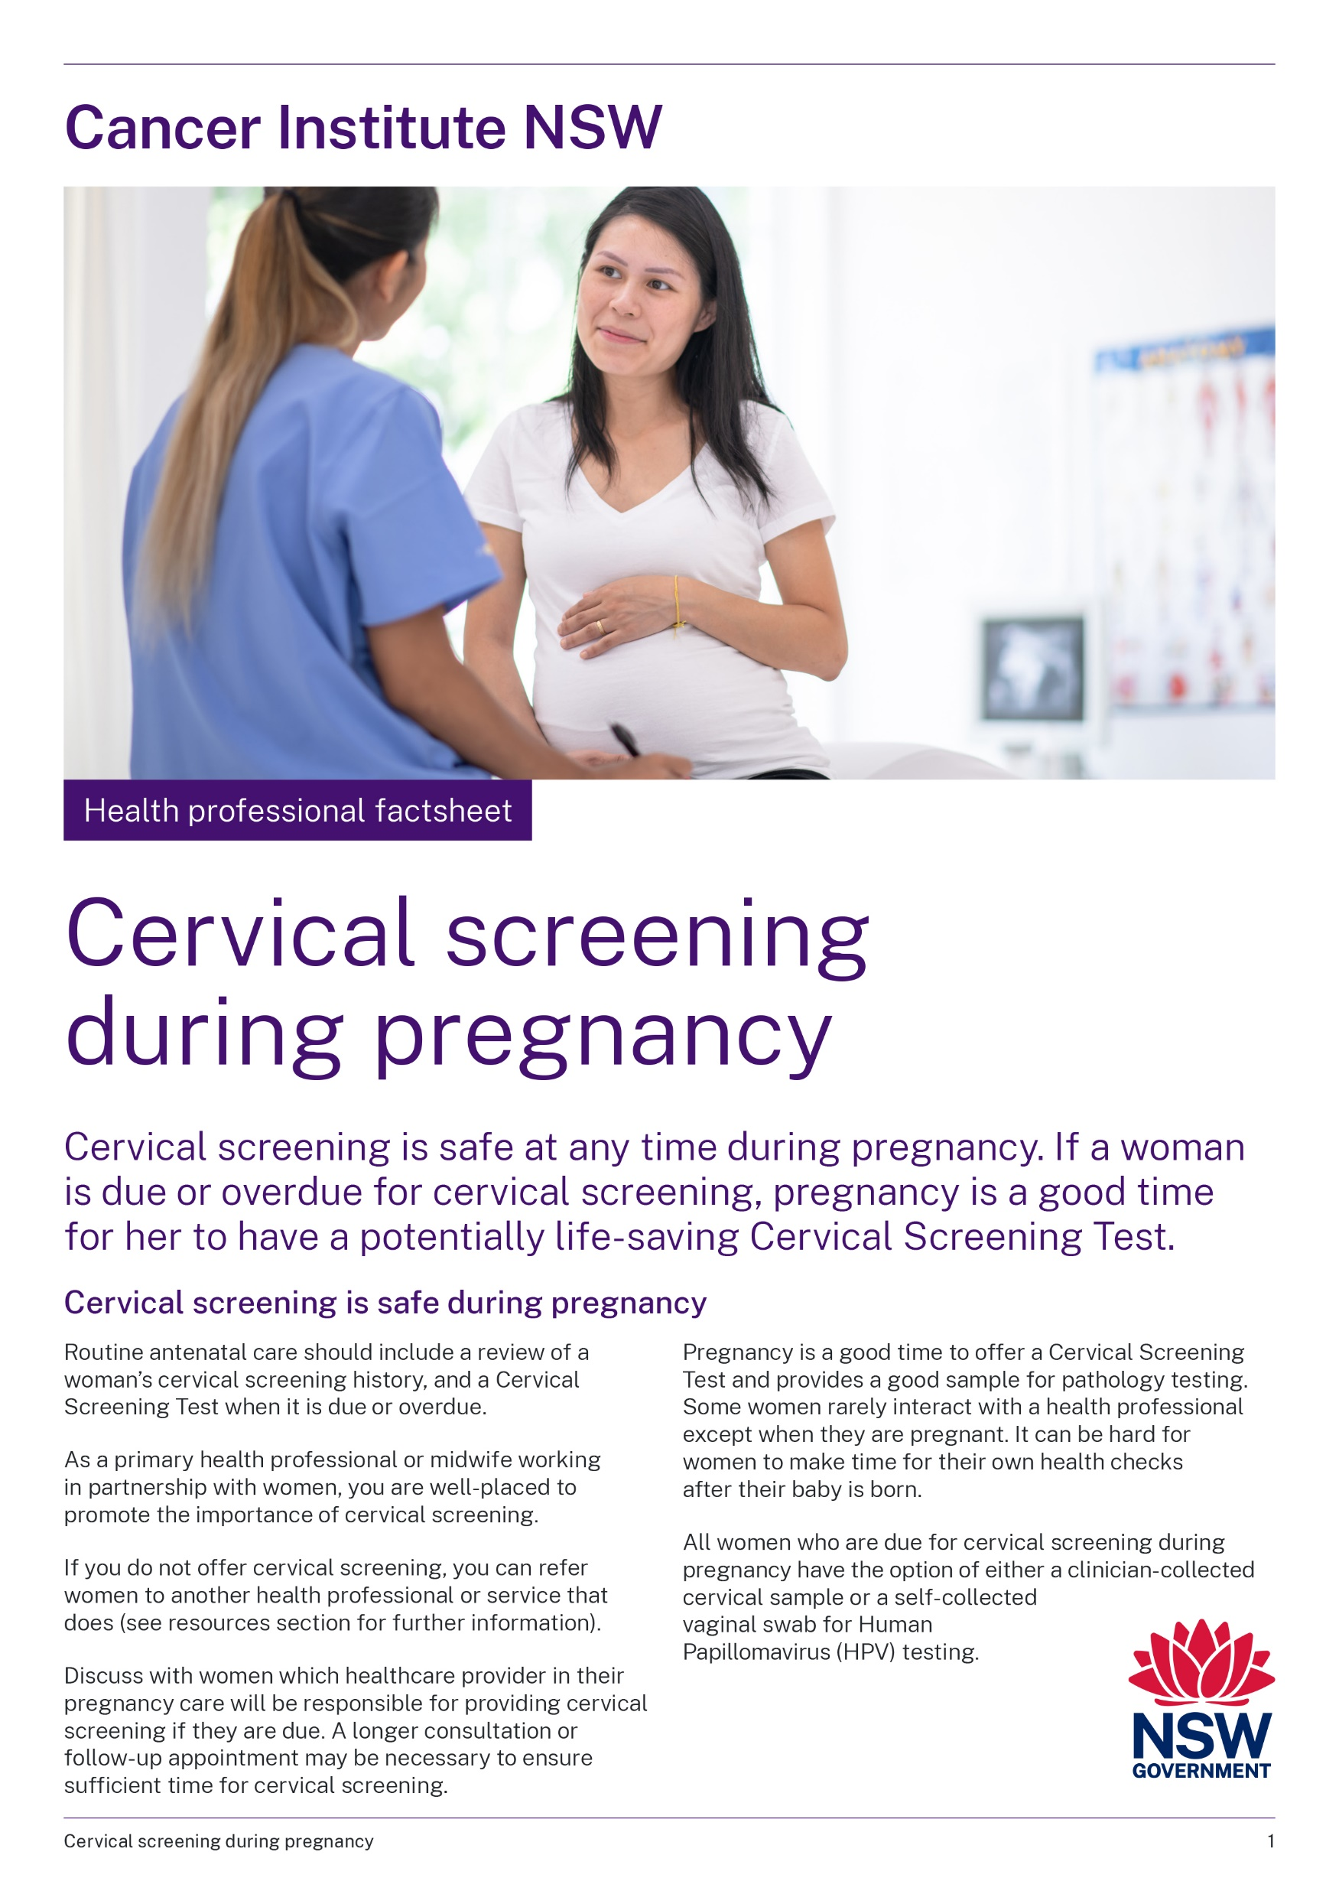
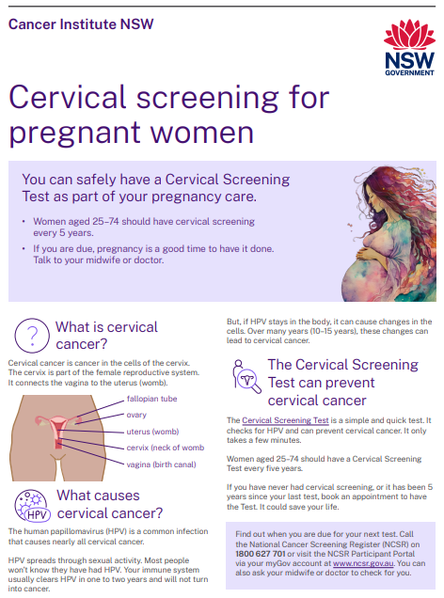
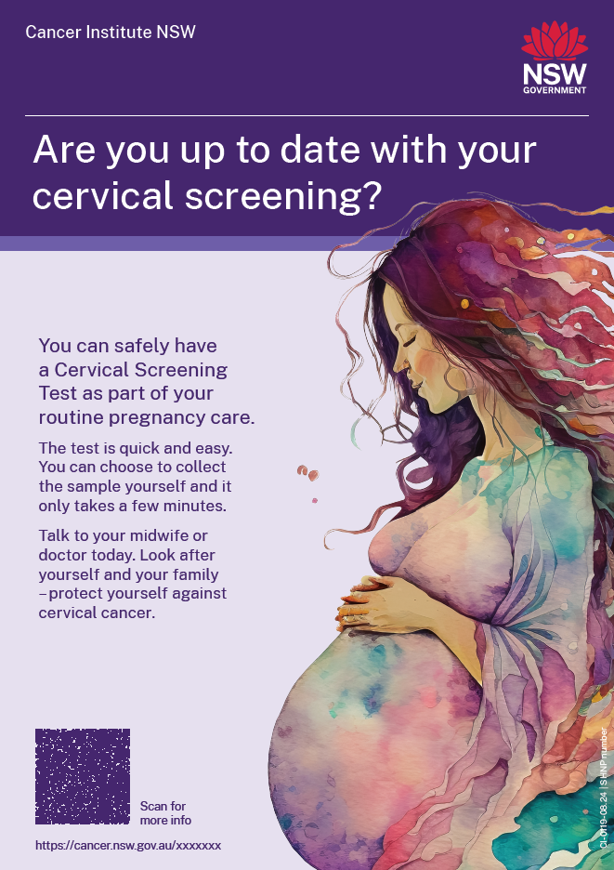
Resources and more information
For Health Professionals:
Cancer Institute NSW factsheets, webpage, videos, clinic posters and mouse pads
National Cervical Screening Program Guidelines (Section 7.1 Pregnancy) and resources, including Healthcare provider toolkit - health.gov.au/our-work/NCSP-healthcare-provider-toolkit
  Australian Centre for the Prevention of Cervical Cancer – factsheets and webinars https://acpcc.org.au/practitioners/resource-hub/
  For pregnant people:
  Web page and factsheet – www.cancer.nsw.gov.au/cervical-screening-when-pregnant
Patient brochures – health.gov.au/resources/publications/national-cervical-screening-program-a-guide-to-understanding-your-cervical-screening-test-results

Slide 24
Training and education
Practical skills training:
  Family Planning Australia comprehensive cervical screening course for clinicians: fpnsw.org.au/cervical-screening-comprehensive-skills-training
Free online training modules and clinical education:
  Updated National Cervical Screening Program Education Course - https://www.health.gov.au/news/updated-cervical-screening-education-course
  Australia Centre for the Prevention of Cervical Cancer (ACPCC) Clinical Education courses:
    Cervical Screening, HPV and Self-collection
    National Cervical Screening Program Bundle
You can also contact your PHN Primary Care Support for assistance

Slide 25
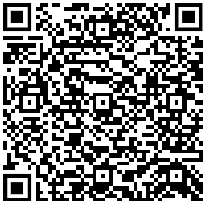
How to contact the NSW Cervical Screening Program
Email to: CINSW-CervicalScreening@health.nsw.gov.au
Visit our website: www.cancer.nsw.gov.au/prevention-and-screening/screening-and-early-detection/cervical-screening

