Slide 1

The specialists
Which one will you be?

Slide 2
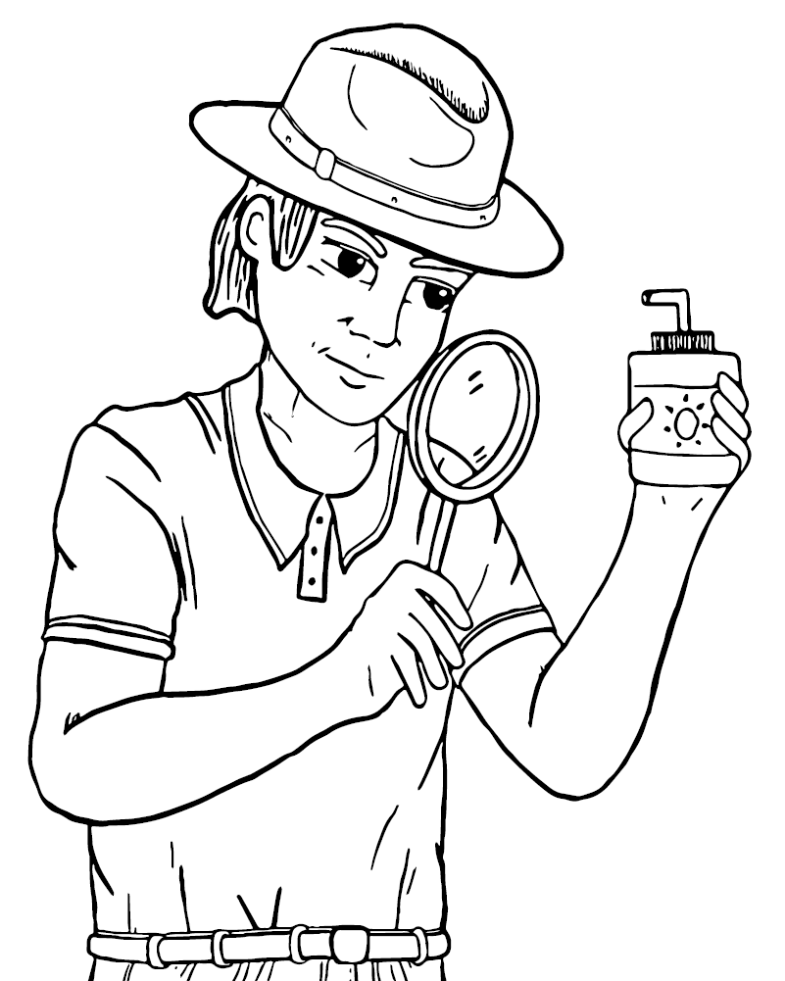
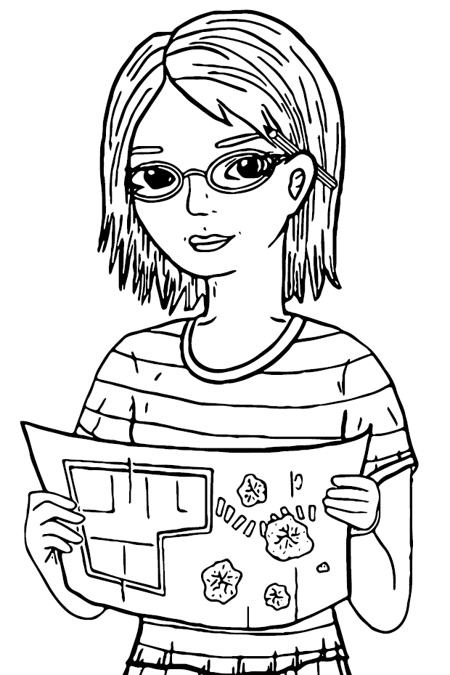

Slide 3
Do you like to ask questions and know the truth?
You could be a
Myth buster

Slide 4
Do you like to draw and make things?
You could be a
Designer

Slide 5
Myth busters:
Question
Explore
Find
Ask
Discover

Slide 6
Designers:
Design
Measure
Draw
Paint
Make

Slide 7
Which one will you be?

Slide 8
Individually, we are one drop.
Together, we are an ocean. – Ryunosuke Satoro

